Slide 1
IoT Security
Pairing Devices issues

Slide 2
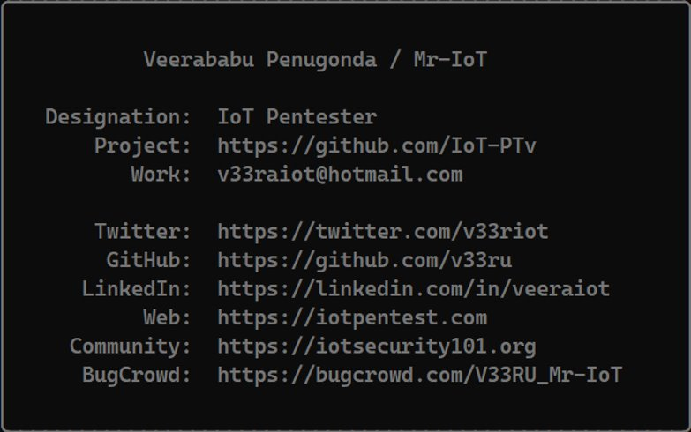
About me..!

Slide 3
Agenda..
IoT Security
Base Architecture
Pairing things security
BLE Attacks
Modernized attacks
Conclusion

Slide 4

IoT Security
The confusion where exactly started
No Clarity
Notes:
The Confusion is where and how to start in Securing IoT,
Clarity – what is bug and what is feature , what is standards

Slide 5
The confusion
Transportation and Logistics
Energy Management
Environmental Monitoring
Retail
Smart Grids
Insurance and Telematics
Sports and Fitness
Smart Appliances
Financial Services
IoT/IIoT/IoMT
Home Automation
Wearable Devices
Healthcare
Industrial IoT (IIoT)
Smart Cities
Agriculture
Notes:
. So many names and different fields and different fucntionalities

Slide 6
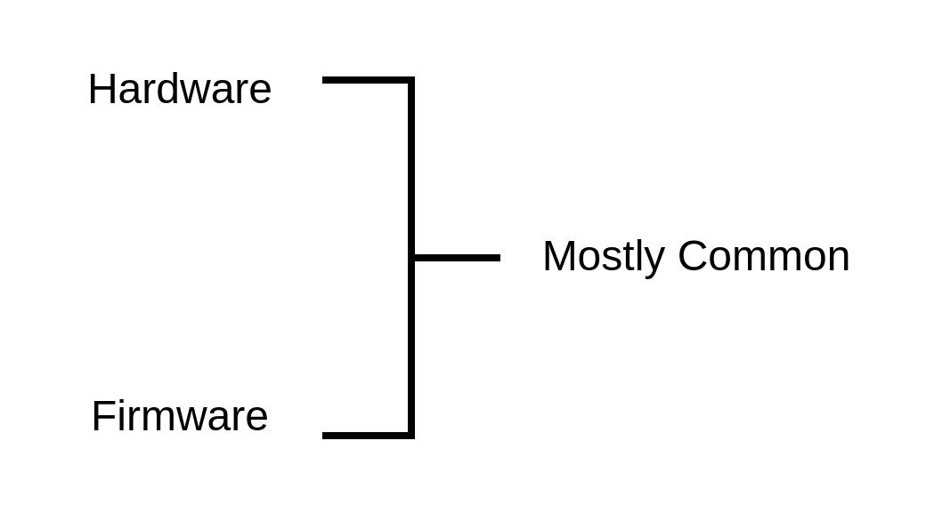

Clarity

Slide 7
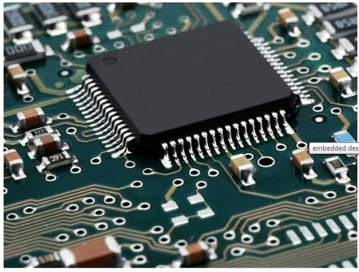
Base Architecture – Embedded
Chips
Debug ports
PCB Design
Low level Concepts
Storage medium
I/O Ports
Embedded Antenna's

Slide 8
Base Architecture - Firmware's
Architecture – ARM/MIPS/AARCH/RISC/SPARC many
Binary Reversing
Crash bug hunting
Static Analysis
Dynamic Analysis
Decompiling

Slide 9
Pairing Things
There are many in wired and wireless connectivity
BLE – Low Energy Concept
Era – Bluetooth to BLE – Controlling things

Slide 10
Bluetooth Attacks
Vulnerabilities in Bluetooth:
Authentication and authorization issues
MiTM
DoS
MAC Spoofing
PIN Cracking
Brute force
In Android/iOS MObile Bluetooth :
RCE Remote code Execution
EoP Elevation of Privilege
ID Information Disclosure
DoS Denial of Service
PAIR Pairing without Auth
In Hardware level:
Chip based
Memory Leakage

Slide 11
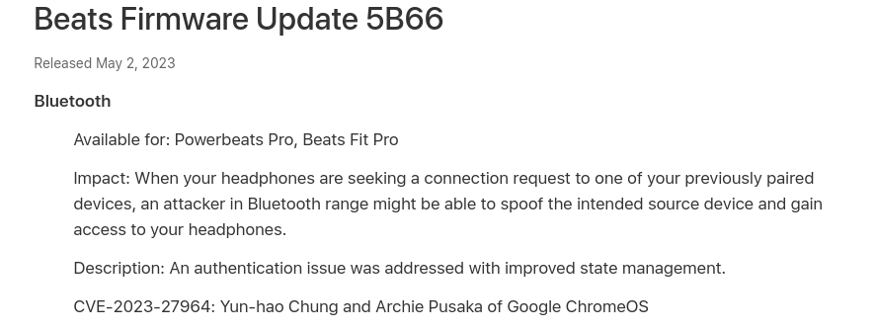
Recent CVE

Slide 12
Demo – UN-Auth
Show pair request
Show random | public
Read the data

Slide 13
Modernized Attacks
Process depends on understanding
Analyze target from all sources
Breaking encryption
Hardcoded data from Firmware/Mobile Apps
Inside device Communication (tcpdump analysis)
Play with stack more than visible attacks

Slide 14
Demo - MiTM

Slide 15
Good Resources
https://github.com/V33RU/IoTSecurity101#ble-intro-and-sw-hw-tools-to-pentest
engn33r/awesome-bluetooth-security: List of Bluetooth BR/EDR/LE security resources (github.com)

Slide 16
Quiz

Slide 17
Q1 : Which attack has deadlock vulnerabilities?
Sweyntooth
B. Braktooth
C. Blueborne
D. None of the above

Slide 18
Q2: Which type of encryption does Bluetooth 5 use to secure data transmissions?
AES
B. AES-128
C. AES-356
D. AES-256

Slide 19
Q3: What is the main security concern associated with the "BleedingTooth" vulnerability in Bluetooth Low Energy (BLE) chips?
A) Eavesdropping on data transmissions
B) Unauthorized access to the device's settings
C) Denial-of-Service (DoS) attacks
D) Remote code execution

Slide 20
Q4: Which of the following is a well-known Bluetooth vulnerability that affected Android devices, allowing attackers to perform remote code execution?
A) Heartbleed vulnerability
B) BlueBorne vulnerability
C) Spectre and Meltdown vulnerabilities
D) Stage fright vulnerability

Slide 21
Q5: what latest version in bluetooth ?
Bluetooth 5
B. Bluetooth 5.1
C. Bluetooth 5.2
D. Bluetooth 5.3

Slide 22
Correct Answers
Q1. A
Q2. D
Q3. D
Q4. A
Q5. D

Slide 23
Answers

Slide 24
Thank You!

